Slide 1
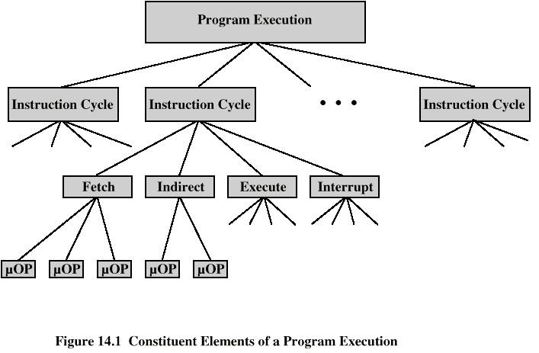
Constituent Elements of
Program Execution

Slide 2
Micro-Operations
A computer executes a program
Fetch/execute cycle
Each cycle has a number of steps
Called micro-operations
Each step does very little
Atomic operation of CPU

Slide 3
Types of Micro-operation
Transfer data between registers
Transfer data from register to external
Transfer data from external to register
Perform arithmetic or logical ops

Slide 4
William Stallings
Computer Organization and Architecture
8th Edition
Chapter 15
Control Unit Operation

Slide 5
Functional Requirements(of Control Unit)
Define basic elements of processor
Describe micro-operations processor performs
Determine functions control unit must perform

Slide 6
Registers
Memory Address Register (MAR)
  Connected to address bus
  Specifies address for read or write op
Memory Buffer Register (MBR)
  Connected to data bus
  Holds data to write or last data read
Program Counter (PC)
  Holds address of next instruction to be fetched
Instruction Register (IR)
  Holds last instruction fetched/current instruction being executed

Slide 7
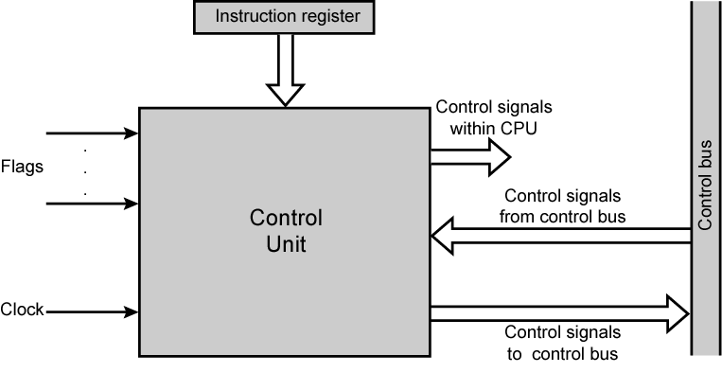
Model of Control Unit

Slide 8
Functions of Control Unit
Sequencing
  Causing the CPU to step through a series of micro-operations
Execution
  Causing the performance of each micro-op
This is done using Control Signals→→

Slide 9
Control Signals( input )
Clock
  One micro-instruction (or set of parallel micro-instructions) per clock cycle
Instruction register
  Op-code for current instruction
  Determines which micro-instructions are performed
Flags
  State of CPU
  Results of previous operations
From control bus
  Interrupts
  Acknowledgements

Slide 10
Control Signals - output
Within CPU
  Cause data movement
  Activate specific functions
Via control bus
  To memory
  To I/O modules

Slide 11
Control Unit Organization

Slide 12
Implementation
All the control unit does is generate a set of control signals
Each control signal is on or off
Represent each control signal by a bit
Have a control word for each micro-operation
Have a sequence of control words for each machine code instruction
Add an address to specify the next micro-instruction, depending on conditions

Slide 13
William Stallings
Computer Organization and Architecture
8th Edition
Chapter 16
Micro-programmed Control

Slide 14
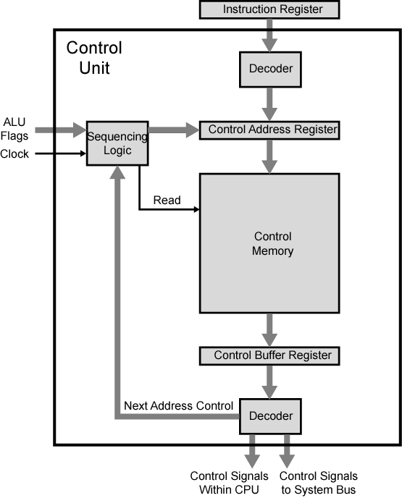
Functioning of Micro programmed
Control Unit

Slide 15
Micro programmed Control Unit Function
Sequence logic unit issues read command
Word specified in control address register is read into control buffer register
Control buffer register contents generates control signals and next address information
Sequence logic loads new address into control buffer register based on next address information from control buffer register and ALU flags

Slide 16
Next Address Decision
Depending on ALU flags and control buffer register
  Get next instruction
    Add 1 to control address register
  Jump to new routine based on jump microinstruction
    Load address field of control buffer register into control address register
  Jump to machine instruction routine
    Load control address register based on opcode in IR

Slide 17
Advantages and Disadvantages of Microprogramming
Simplifies design of control unit
  Cheaper
  Less error-prone
Slower

Slide 18
Tasks Done By Microprogrammed Control Unit
Microinstruction sequencing
Microinstruction execution
Must consider both together

Slide 19
Micro-instruction Types
Each micro-instruction specifies many different micro-operations to be performed in parallel
  (horizontal micro-programming)
Each micro-instruction specifies single (or few) micro-operations to be performed
  (vertical micro-programming)

Slide 20
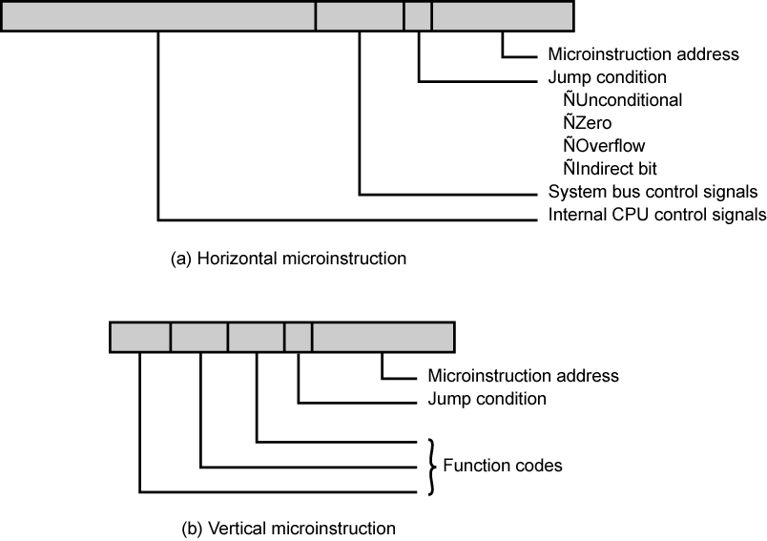
Typical Microinstruction Formats

Slide 21
Vertical Micro-programming
Width is narrow
Limited ability to express parallelism
Considerable encoding of control information requires external memory word decoder to identify the exact control line being manipulated

Slide 22
Horizontal Micro-programming
Wide memory word
High degree of parallel operations possible
Little encoding of control information

Slide 23
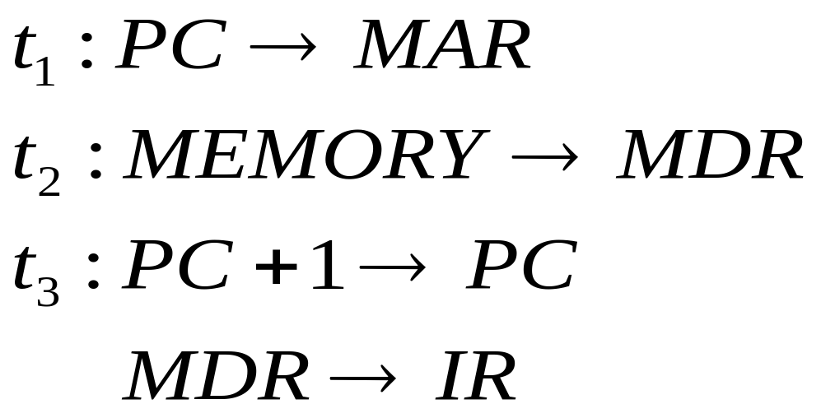
Fetch Sequence (symbolic)

Slide 24
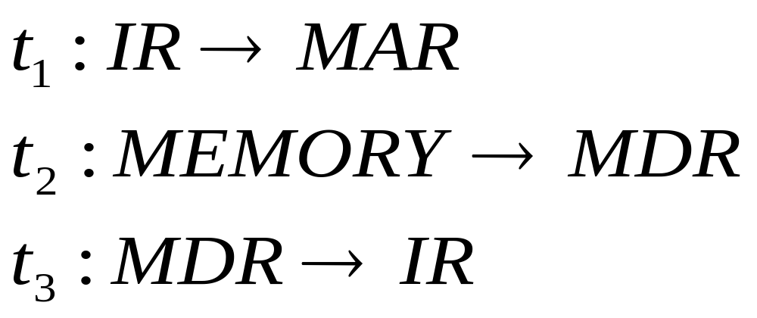
Indirect Cycle

Slide 25
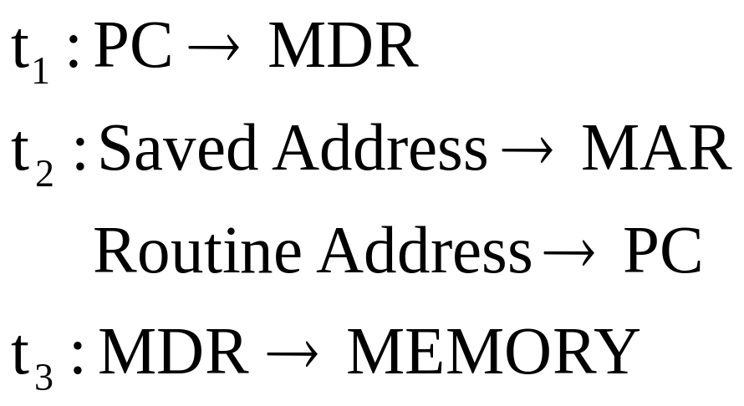
Interrupt Cycle

Slide 26
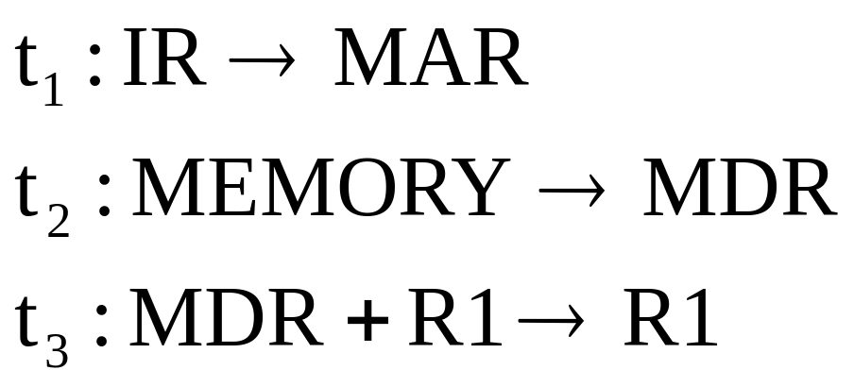
Execute Cycle (ADD)
Different for each instruction
e.g. ADD R1,X - add the contents of location X to Register 1 , result in R1

